Slide 1
Global Scheduling Based Real Time Multicore Scheduling

Slide 2
Motivation

Slide 3
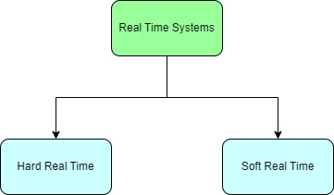
Real time Systems and Multi-core processors
Concurrency.
Parallelism.
Tasks must be completed within strict timing constraints.
Soft Real Time and Hard Real Time.

Slide 4
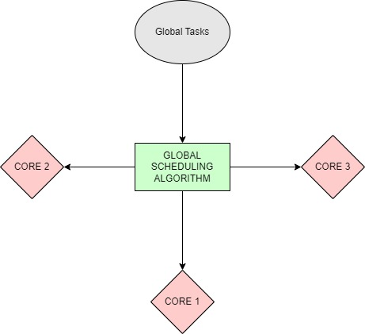
Global Scheduling and applications
Assigns global tasks to a pool of cores.
Allows tasks to migrate between cores.
A single or multiple queue is shared among cores.

Slide 5
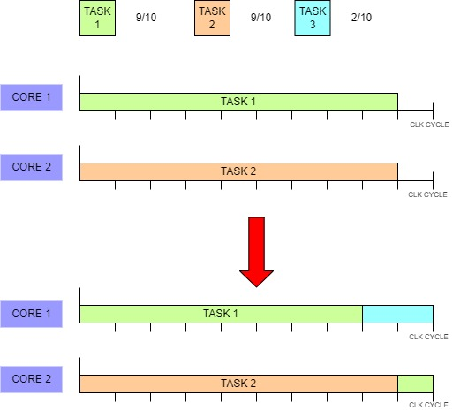
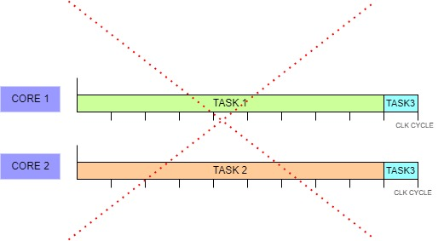
Practical illustration of G.s

Slide 6
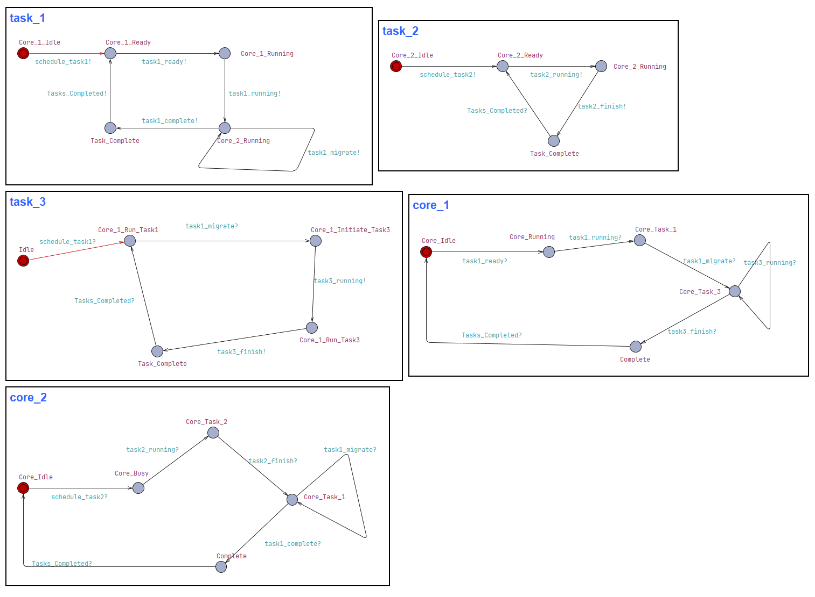
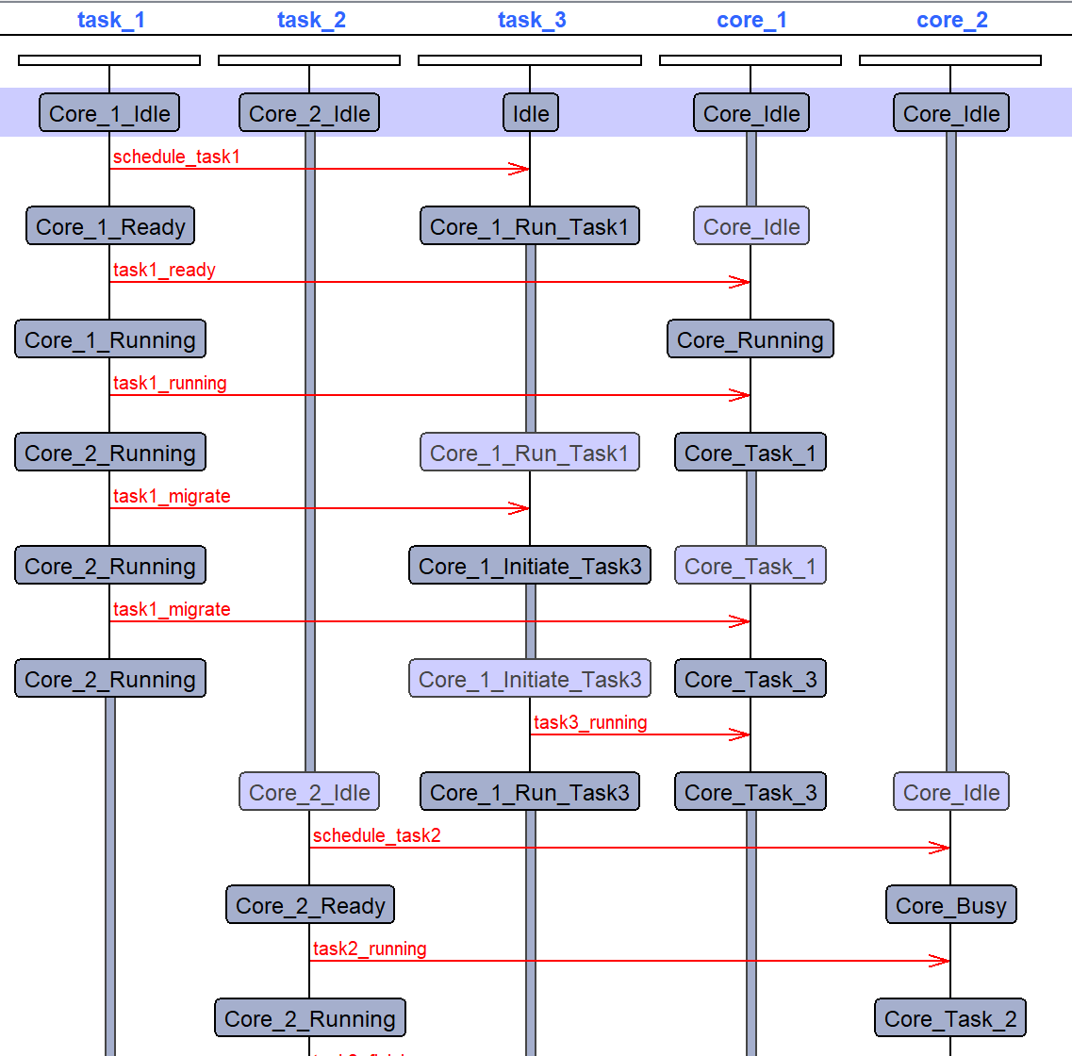
UPPAAL and sequence diagram

Slide 7
Summary
Global Scheduling : Allocates tasks across all available cores for better resource utilization.
Ensures tasks meet their deadlines in time-sensitive environments.
Benefits : Improved flexibility, resource utilization, and scalability
Challenges: Increased overhead, complexity, and ensuring fairness in resource distribution.
Applications: Embedded systems, HPC, and consumer electronics.

Slide 8
References
Buttazzo, G.C. (2011) ‘6’, in Hard real-time computing systems: Predictable scheduling algorithms and applications. 3rd edn. New York: Springer.
Ismail, H., Jawawi, D. N. A., & Isa, M. A. (2015). A weakly hard real-time tasks on global scheduling of multiprocessor systems. IEEE.
H. Ismail, D. N. A. Jawawi and M. Adham Isa, "A weakly hard real-time tasks on global scheduling of multiprocessor systems," 2015 9th Malaysian Software Engineering Conference (MySEC), Kuala Lumpur, Malaysia, 2015, pp. 123-128, doi: 10.1109/MySEC.2015.7475207. keywords: {Real-time systems;Program processors;Optimal scheduling;Scheduling algorithms;Time factors;Algorithm design and analysis;weakly hard real-time tasks;multiprocessor systems;weakly hard scheduling approach;global scheduling;deadline models},
Q. Zhou, G. Li and J. Li, "Improved Carry-in Workload Estimation for Global Multiprocessor Scheduling," in IEEE Transactions on Parallel and Distributed Systems, vol. 28, no. 9, pp. 2527-2538, 1 Sept. 2017, doi: 10.1109/TPDS.2017.2679195.keywords: {Processor scheduling;Time factors;Interference;Scheduling;Estimation;Upper bound;Real-time systems;Real-time scheduling;multiprocessor;global scheduling;response time analysis}.

